Slide 1

House Pricing
Submitted by:-
VINOD ADEP

Slide 2
ACKNOWLEDGMENT :-
I Would likely to express my special thanks to Flip Robo technology for given me a wonderful opportunity to explore on Large Dataset and Data Science Project
I have to say special thanks to Data Trainded Mentor’s had guided me to Solving logical problems and explained project concept in deeply.
Link that helps me to complete this project:
https://scikit-learn.org/stable/modules/generated/sklearn.linear_model.LinearRegression.html
https://scikit-learn.org/stable/modules/generated/sklearn.linear_model.RandomForesrRegressor.html
https://scikit-learn.org/stable/modules/generated/sklearn.linear_model.DecisionTreeReRegressor.html
https://scikit-learn.org/stable/modules/generated/sklearn.impute.KNNImputer.html

Slide 3
INTRODUCTION
Business Problem Framing :-
Houses are one of the necessary need of each and every person around the globe and therefore housing and real estate market is one of the markets which is one of the major contributors in the world’s economy. It is a very large market and there are various companies working in the domain. Data science comes as a very important tool to solve problems in the domain to help the companies increase their overall revenue, profits, improving their marketing strategies and focusing on changing trends in house sales and purchases. Predictive modelling, Market mix modelling, recommendation systems are some of the machine learning techniques used for achieving the business goals for housing companies. Our problem is related to one such housing company.
A US-based housing company named Surprise Housing has decided to enter the Australian market. The company uses data analytics to purchase houses at a price below their actual values and flip them at a higher price. For the samepurpose, the company has collected a data set from the sale of houses in Australia. The data is provided in the CSV file below.
The company is looking at prospective properties to buy house to enter the market. You are required to build a model using Machine Learning in order to predict the actual value of the prospective properties and decide whether to invest in them or not.

Slide 4
Review of Literature :-
Type of houses
This is a comprehensive summary of the research done on the topic. The review should enumerate, describe, summarize, evaluate and clarify the research done.
Motivation for the Problem Undertaken :-
Motivation of this project is to determine which feature are affecting much to predict the sale price. Here, there are number of feature and motive is to extract a those feature’s which is more usefull for to predict the sale price of the house.

Slide 5
Analytical Problem Framing
Mathematical/ Analytical Modeling of the Problem :-
In this sample data have soo many feature’s. Some of feature’s have heighly correlated to our target column i.e Sale price. Data set have both categorical and continues data. Training data set contains 1168 observations and have 80 features with one target column. Some of the continues column’s have skewness. Categorical features have two type ordinal and nominal data. Data set have null values also. Soo, i have handle the null values present in the data set. Handle the skewness columns and convert into normalized column by using Power transformer. I have used to encode ordinal and nominal data seperatly. Firstly i thought to use get dummies or one hot encoder for nominal data but we have soo many nominal feature’s get dummies will create new column to each lables present in respective nominal column. This may lead to heigh dimensional problem which will not perform tree based algorithm. So i have used Mean encode and Label encoder. Label Encoder is used for the ordinal columns

Slide 6
Data Sources and their formats :-
Format of the data set is csv. Pandas I used to read and access the data for understand the structure of the data. From the data set we can see that high number of data is in categorical in ordinal and some of nominal data. Null values also present in the categorical data. Only in one continues column have null values.
Data Pre processing Done :-
In this project I have used in pre processing that is Power Transformer and Standard scaler. My observation is that accuracy of the model varies before pre processing steps and after pre processing. Decision tree and or tree based algorithm not much affect whether we apply pre processing or not. But in another models like Linear Regression have soo much influence of pre processing step. These type of models need pre processing like need to handle outliers, skewness scaling into the similar range to entire data set so model get not biased on certain features while prediction.

Slide 7
Data Inputs- Logic- Output Relationships :-
Aim of this project is to identify the best input’s. Based on this inputs sale price will predict accurately. Here some of the inputs which are highly affecting to predict the sale price like Overall quality of the house which is most important feature to predict the price old house. In this columns have 10 number which are ordinal. 10 means the quality of house is soo rich having well neighbours quality of material used while building the house all the thing’s are consider based on this sale price will increase or decrease. Suppose the quality of houses rated out of 10 have only 3 or 4 this type of houses price have less compared to rating have more than 7. Such that other features also acts over target column i.e sale price and help to predict the price of house.
State the set of assumptions (if any) related to the problem under consideration :-
House Price Prediction is one of the main role in Real Estate buissness , I think we have to add another column in this dataset for different area have different sale price, So that will be very usefull when we deploy project by area location. Also House buyers have get idea about which area is reasonable for purchasing house.

Slide 8
Hardware and Software Requirements and Tools Used :-
Listing Tools and libraries that I have used to solve project:
Software: Anaconda, Jupyter Notebook, Python3
Libraries: Numpy, Pandas, Matplotlib, Seaborn,
Sklearn.

Slide 9
Model/s Development and Evaluation :-
Identification of possible problem-solving approaches (methods) :-
While performing EDA we have got insite information from dataset to predict Sale price. Some of the columns are interdependent like garage area and garege can have number of cars space. Number of cars are directly correlated to area of garage. Multicorrelation will effect some of the models.
Most of the columns are ordinal type which giving the grades, rating and ranks to the house’s which have directly correlation to our target column.
Filling null values have major role in this dataset beacuse dataset have lots of null values in both categorical and continues data. Based on the type of column i have repalce the null values to some other values. I have handle null values in continuos column after encoding entire data set into numerical then after based on all the columns null values are imported bye using KNN Imputer.

Slide 10
Testing of Identified Approaches (Algorithms) :-
I have used some of the model of machine learning like Linear regression, Decision Tree Regressor, Random Forest Regressor. I have used for loop for random state so it can give best random state with accuracy. It used to select best random state to split the data to resepective model and also find best cv(cross validation). Each model have differect random state and cv. I have tested by applying before scaling, after scaling the data. And also before feature selection and after feature selection. How models are giving there output also observed that after scaling the data linear regression model’s accuracy has increase heigh. To handle the problem of over fitting and under fitting the model. Each model will give there out put after tuning the model.
Run and Evaluate selected models :-
In this project I got good accuracies from Linear regression and Random Forest Regressor algorithms.
Linear Regression is used in suppervised regression model. Linear regression is used to fit the best fit line on the basis of that line sale prices would predicted. Best fit line is a line where the difference between actual and predicted values is less that is called best fit line.

Slide 11
Linear regression contain two major values based on this values line would drawn i.e intercept and the slope of the line. Best slope would be calculated by using the gradient decent method with the small learning rate.
Random Forester is a tree based algorithm it cab be used on both classification and regression problems.
Now we have a regression problem so used Random Forest regressor. In this algorithm first it is calculate the impurity of each column and check the information gain. Which gives high information gain that columns becomes a root node then their child would be their features. Then again calcualate the entropy or gini and information gain like this tree will build.
Problem of this algorithm having high chances of over fittig the model which may lead high variance in testing. To prevent this problem we have parameter’s like depth of the tree. If the tree will read each and every point’s then it may have over fitting problem. If we hyper tune this algorithm problem could be solved.

Slide 12
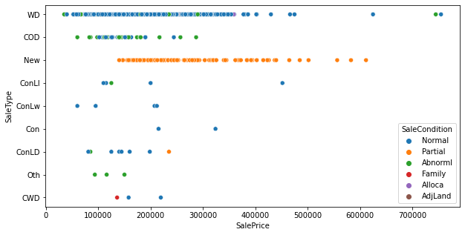
Visualizations : -

Slide 13
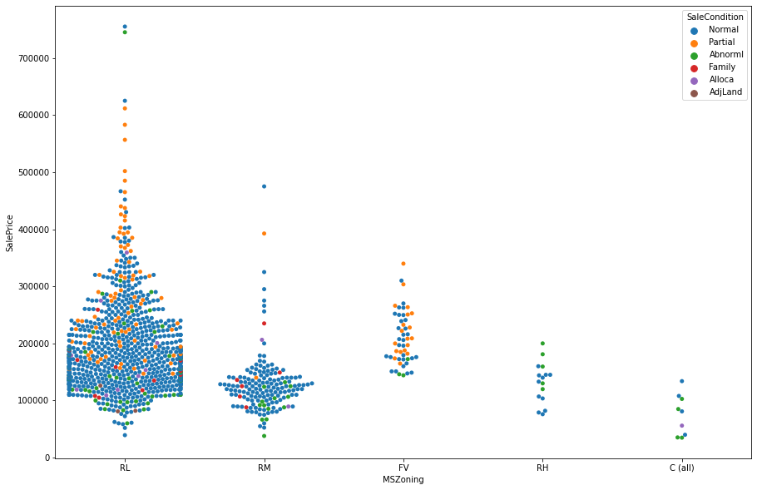

Slide 14
Interpretation of the Results :-
To see the accuracy of each model I have used r2 score. R2 score is the score how good slope has genreate for the best fit line. Linear regression and random foresr regression is giving the r2 score near to 87.05 %.
CONCLUSION
Learning Outcomes of the Study in respect of Data Science :-
I have learn some inbuild funtion of python at the time of data cleaning. Object columns to Integer are done by using python map function over on lambda function and Mean encoder and ordinary encoder. The main challenging is that to run all model by hypertuning each model and fetching each model best random state and best cv once and get the best model name as a result.

